Slide 1

Predicting Heart Attack Risk
DSCI 631 Final Project Presentation
Zach Carlson, Andrew Napolitano, Tyler Beard

Slide 2
AGENDA
Project Overview
Data Overview
EDA and Pipeline Set Up
ML Algorithms
Summary
Final Report
Known Limitations of Project
Potential Future Development

Slide 3
AGENDA
Project Overview
Data Overview
EDA and Pipeline Set Up
ML Algorithms
Summary
Final Report
Known Limitations of Project
Potential Future Development

Slide 4
Intro: Project Overview
Heart Attack Risk Prediction
Dataset on Kaggle ¹
Originally sourced from UCI Machine Learning Repository ²
Public repository available for download on Github ³

Slide 5
AGENDA
Project Overview
Data Overview
EDA and Pipeline Set Up
ML Algorithms
Summary
Final Report
Known Limitations of Project
Potential Future Development

Slide 6
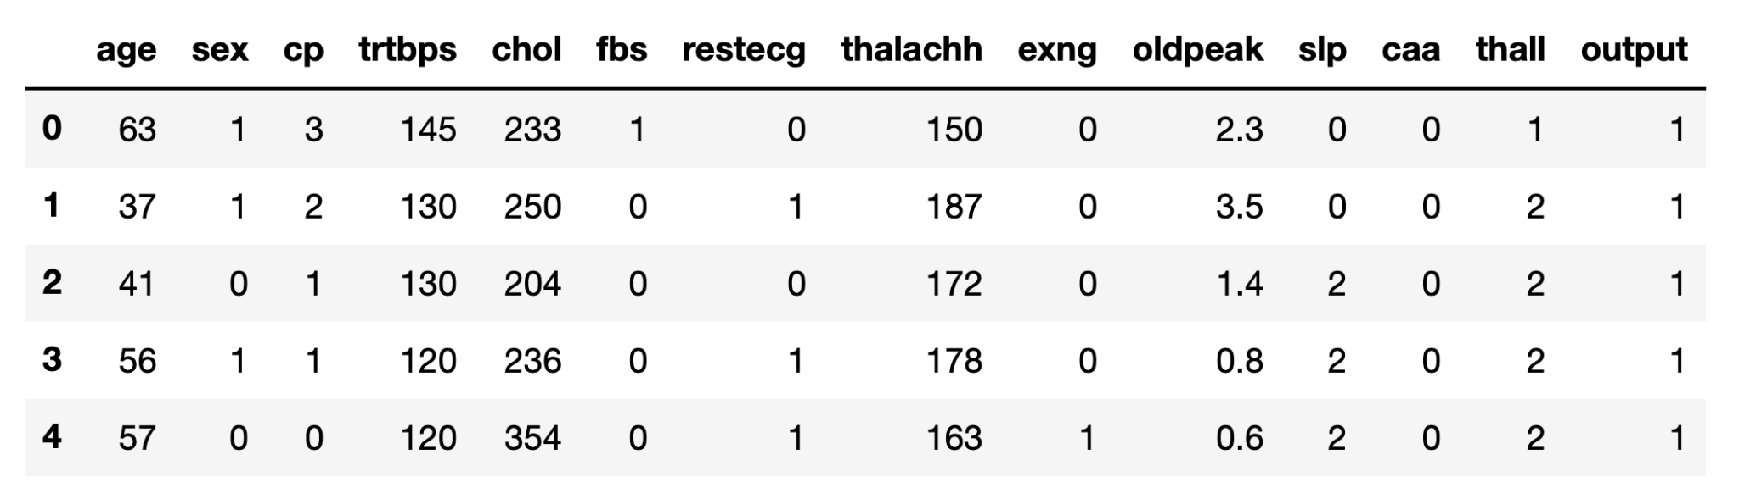
Data Overview
300 instances
13 features and 1 target variable

Slide 7
age: Age of the person (years)
sex: Sex of the person (M or F)
cp: Chest pain type
trtbps: Resting blood pressure (mm Hg)
chol: Cholesterol level (mg/dL)
fbs: Fasting blood sugar (categorical, if > 120 mg/dL)
restecg: Resting EKG results
thalachh: Maximum heart rate achieved (bpm)
exng: Exercise Induced Angina
oldpeak: ST depression ^{4, 5}
slp: Slope of ST segment ^{4, 5}
caa: Number of major vessels
thall: Thalassemia (blood disorder)
output: Target variable

Slide 8
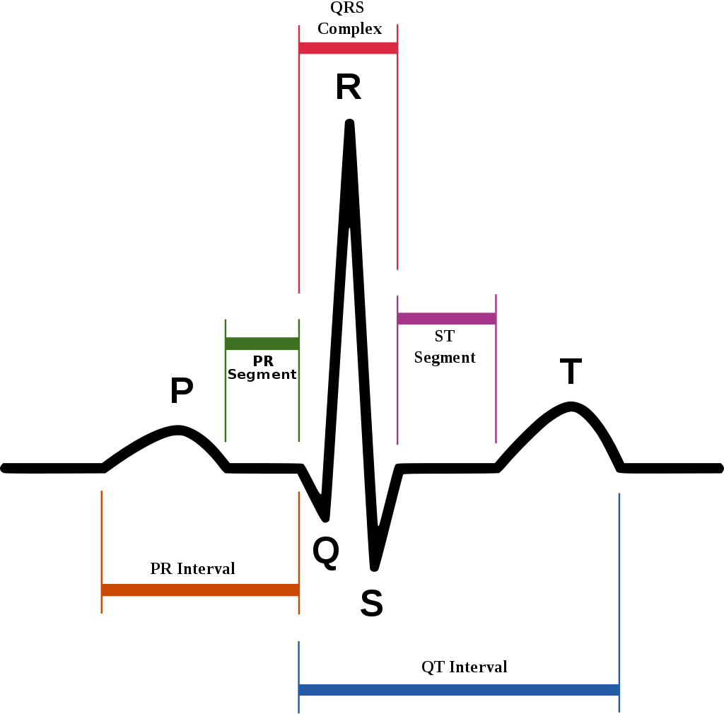
oldpeak, slp
Both relate to the ST segment of a heartbeat
oldpeak: ST depression induced by exercise relative to rest
slp: slope of the peak exercise ST segment

Slide 9
AGENDA
Project Overview
Data Overview
EDA and Pipeline Set Up
ML Algorithms
Summary
Final Report
Known Limitations of Project
Potential Future Development

Slide 10
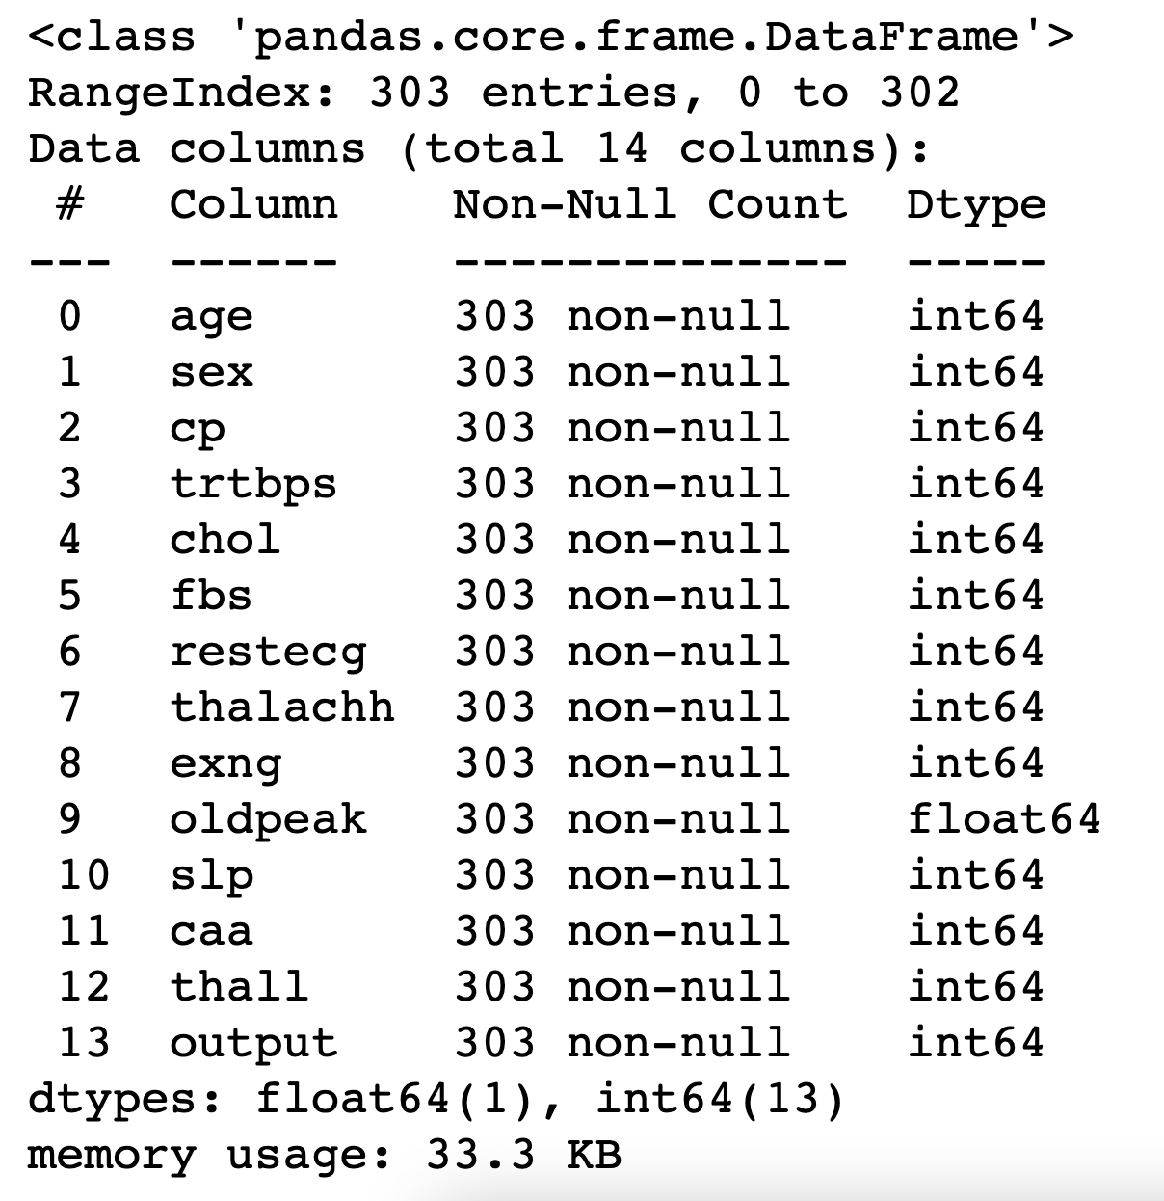
EDA and Pipeline Set Up
heart.info()
All features have datatype int64, expect oldpeak, which has the datatype float64.
No missing/null values.

Slide 11
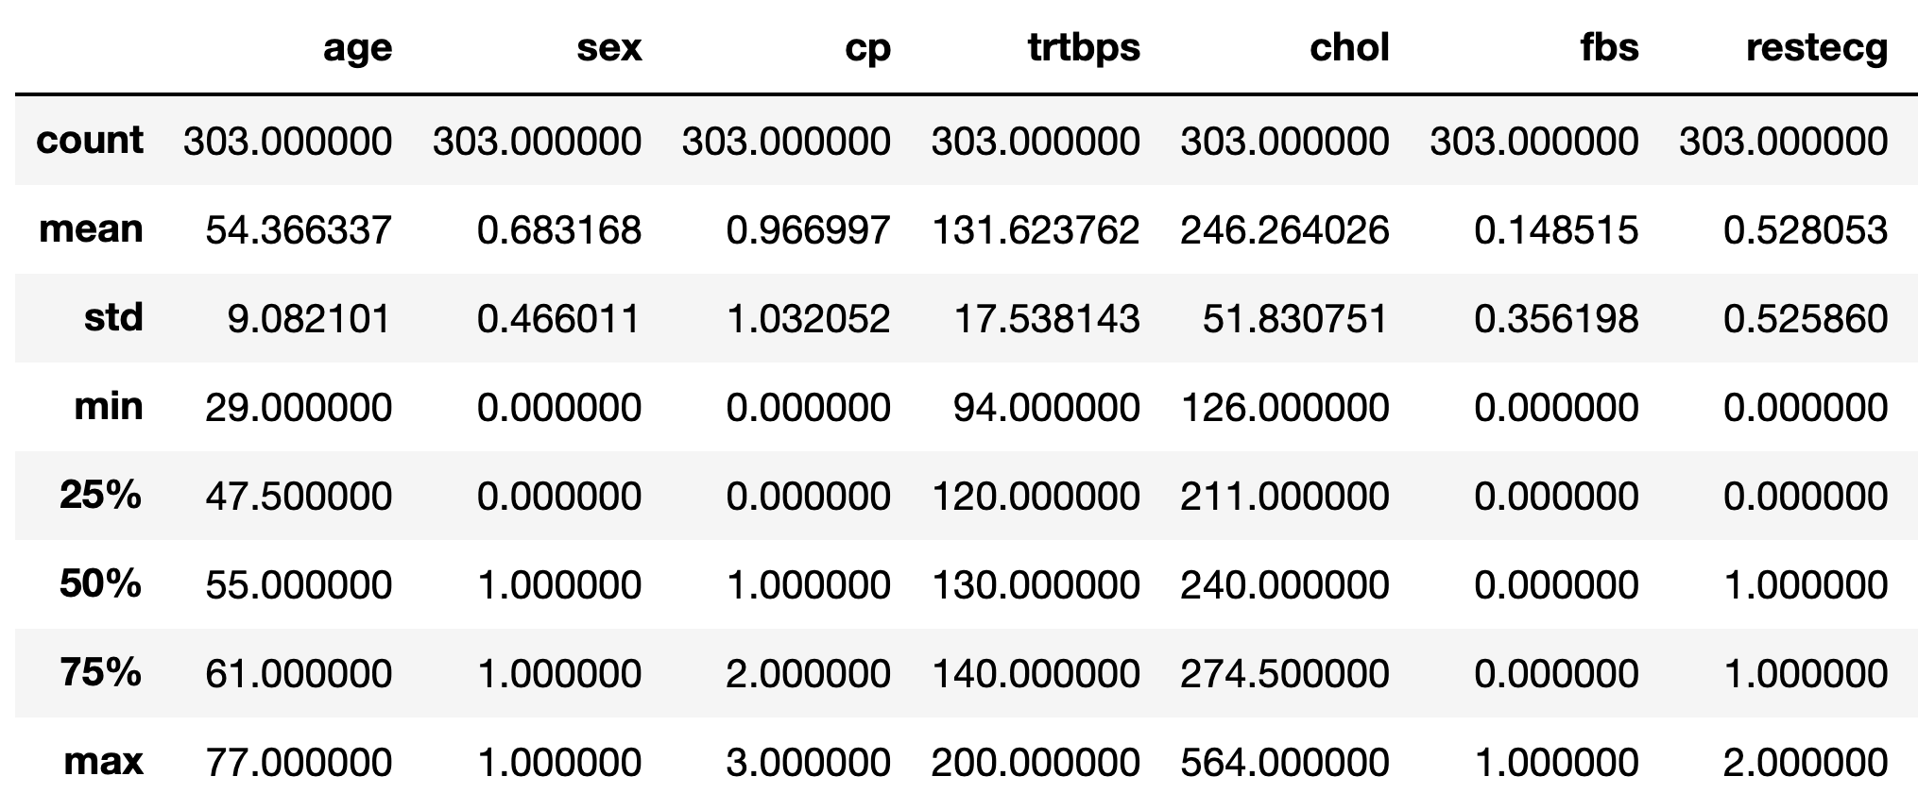
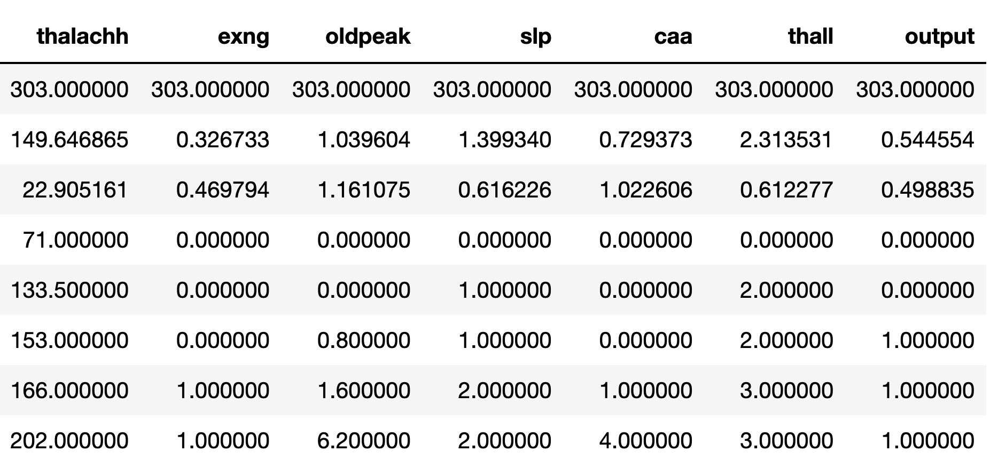
heart.describe()

Slide 12
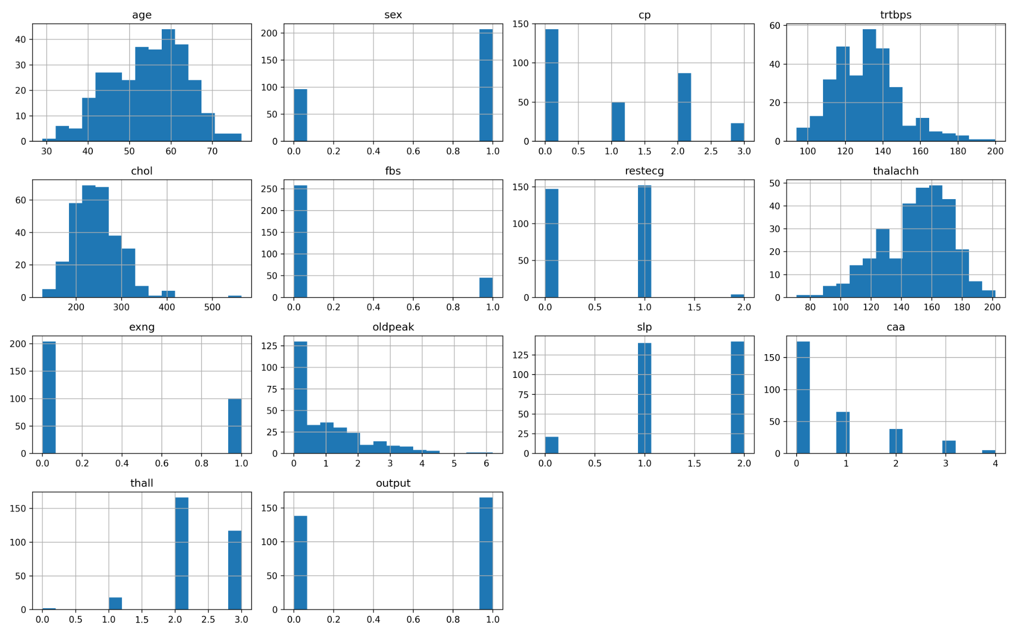
Histogram of all features

Slide 13
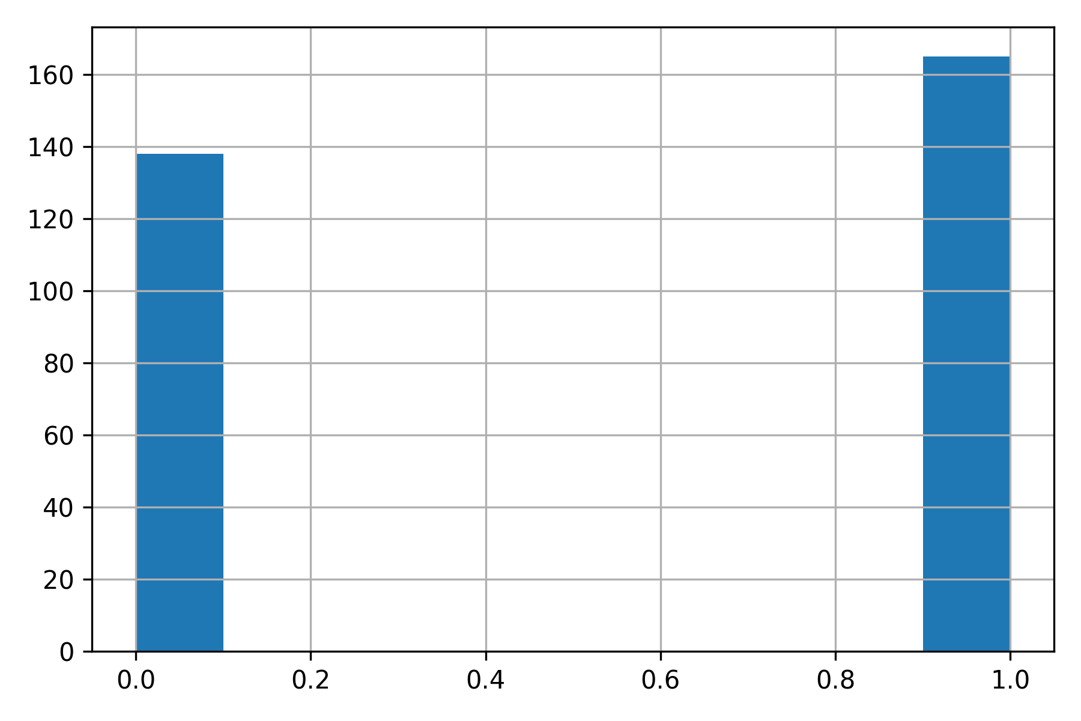
Balance Assessment
heart["output"].hist()
balance_output(heart)
Percentage Not Risk: 45.5%
Percentage Risk: 54.4%

Slide 14
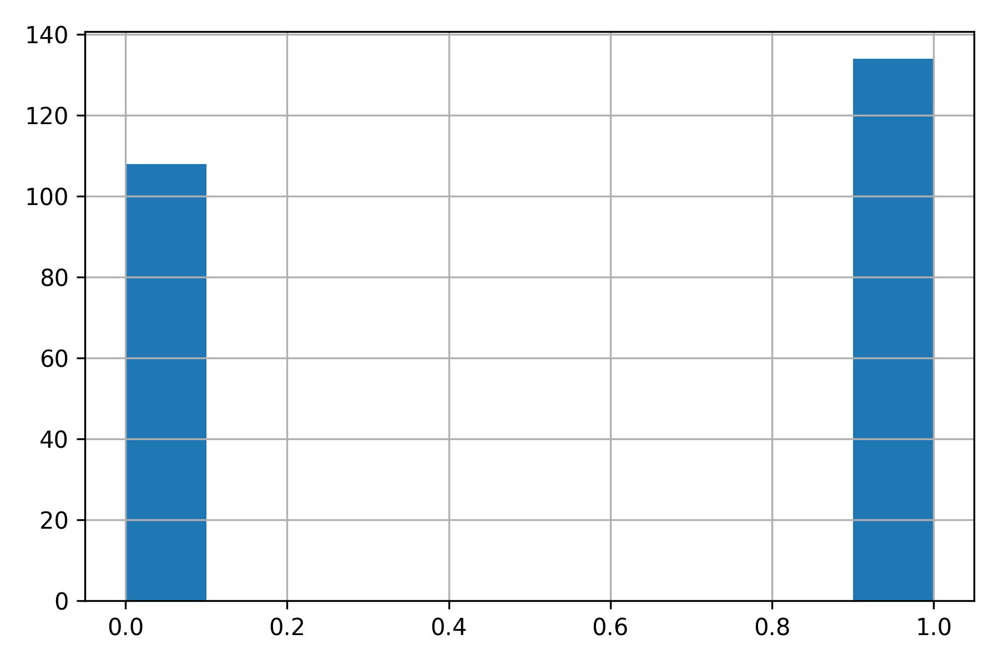
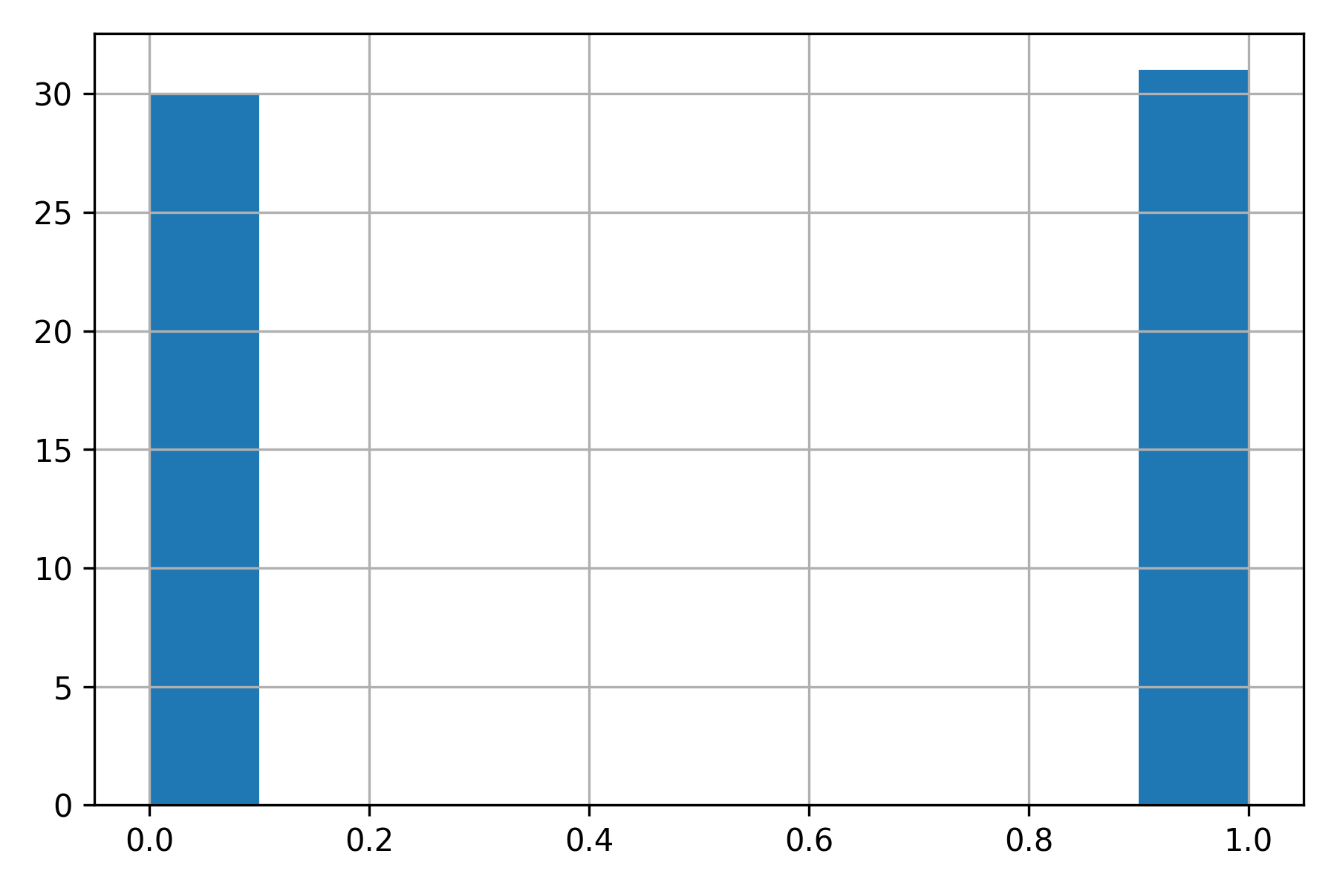
Balance Assessment
Training Set (80% of dataset)
Percentage Not Risk: 44.6%
Percentage Risk: 55.4%
Test Set (20% of dataset)
Percentage Not Risk: 49.2%
Percentage Risk: 50.8%

Slide 15
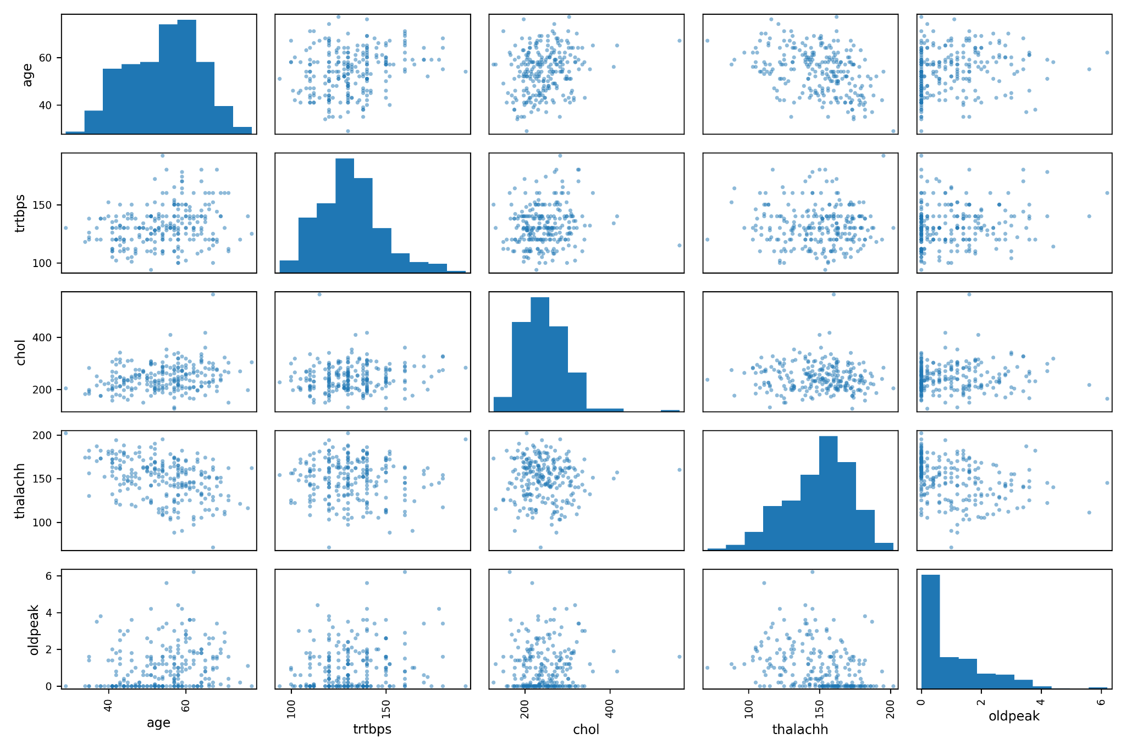

Slide 16
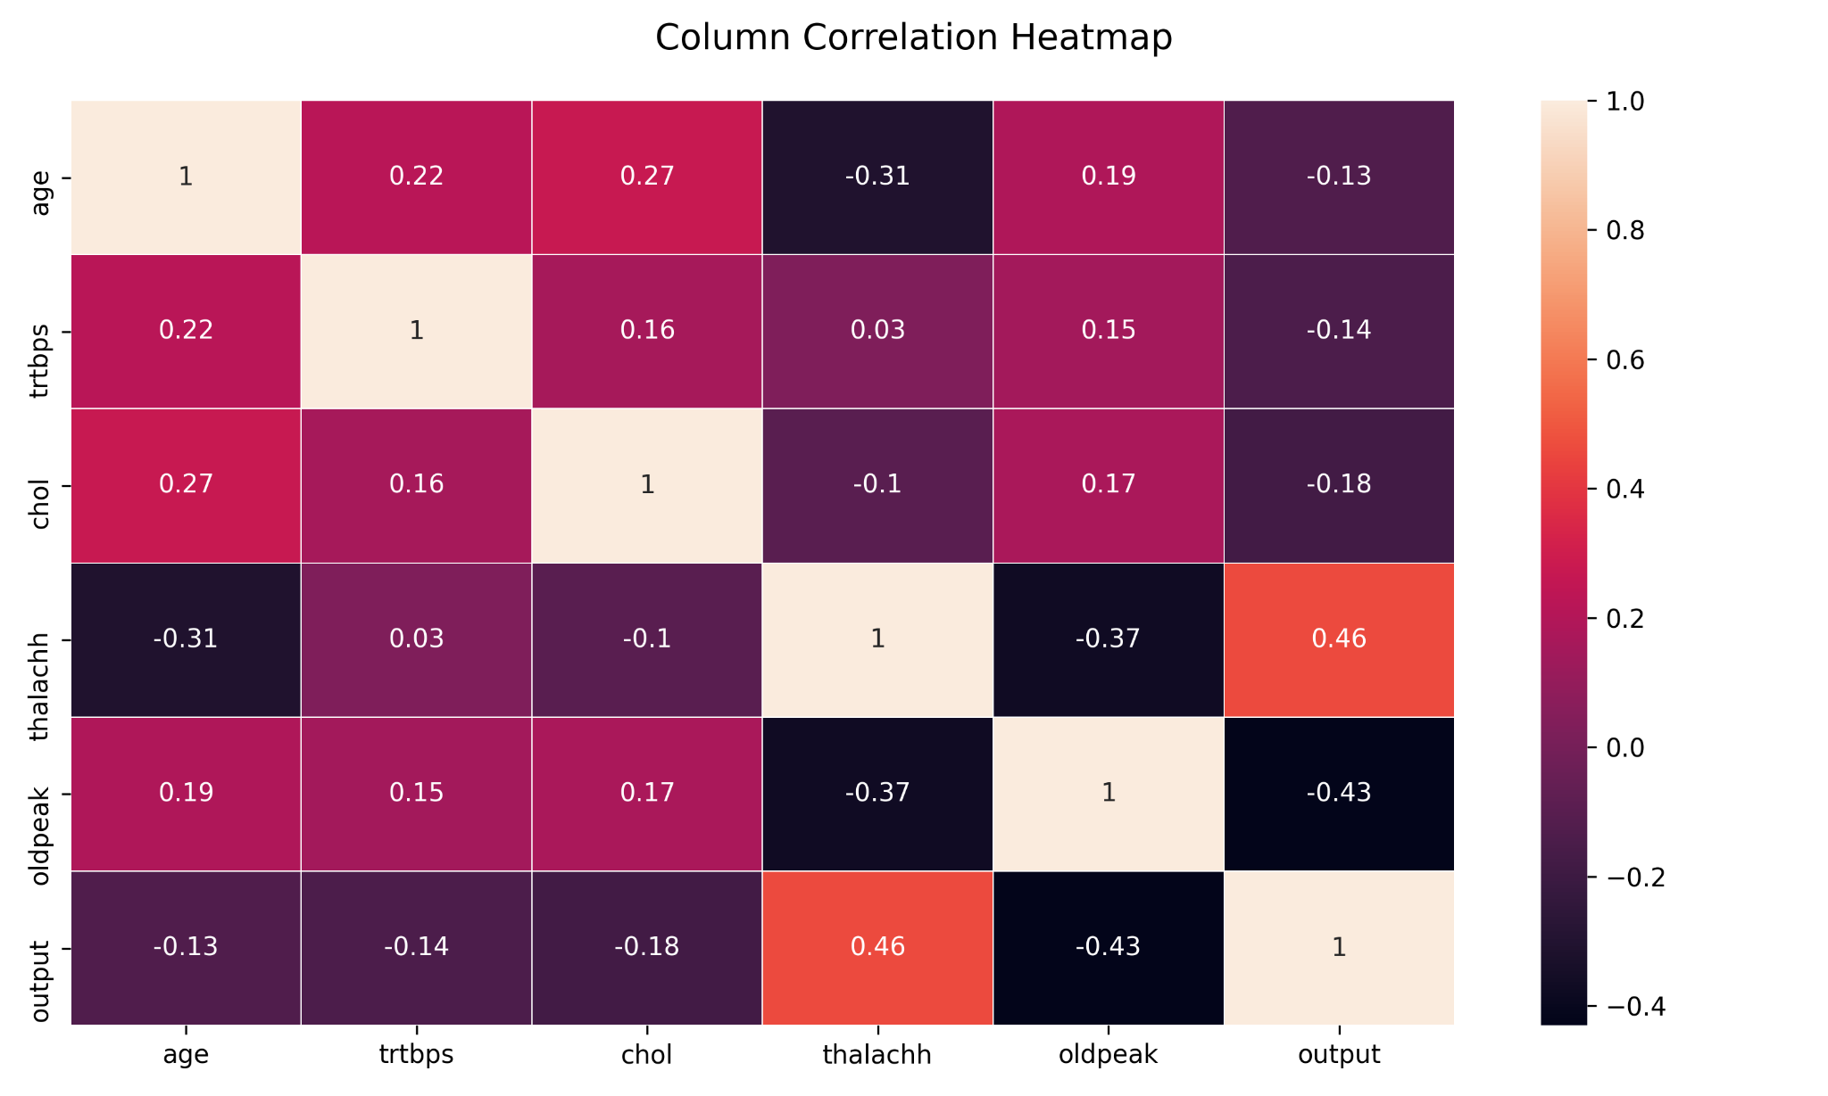
Highest correlation
Between:
age-thalachh (-0.31)
Oldpeak-thalachh (-0.37)
Discard oldpeak. thalachh is more correlated with output

Slide 17
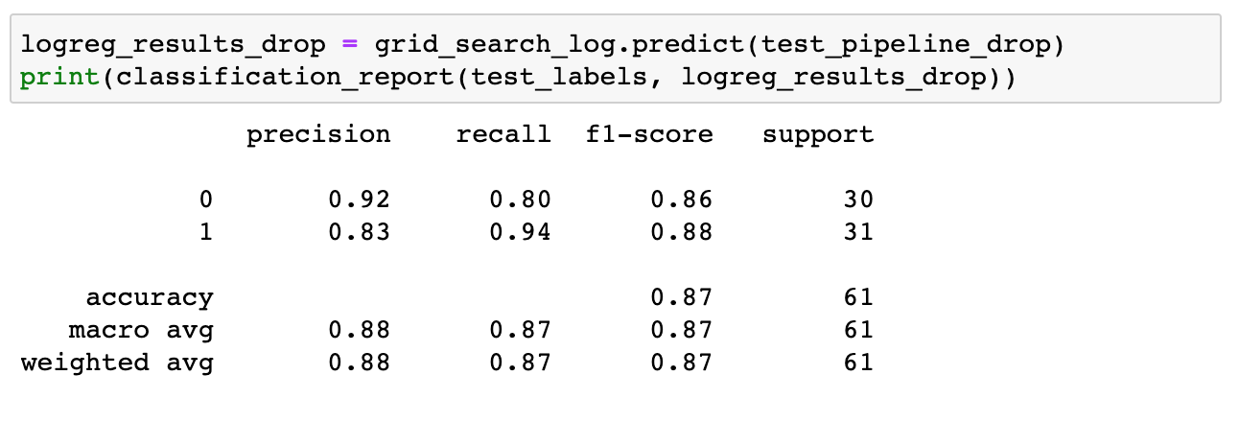
Feature Selection
Removal of oldpeak improves accuracy by 2% when using LogisticRegression

Slide 18
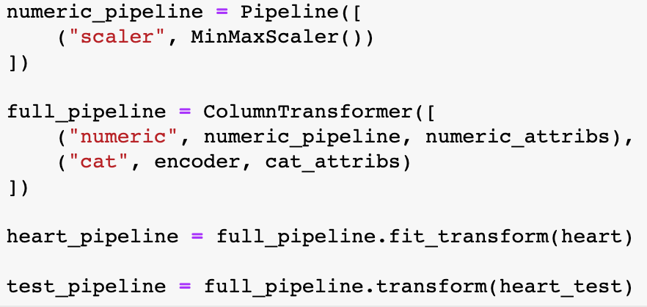
Pipeline Set Up
MinMaxScaler()
OneHotEncoder()
heart_pipeline.shape
(242, 30)

Slide 19
AGENDA
Project Overview
Data Overview
EDA and Pipeline Set Up
ML Algorithms
Summary
Final Report
Known Limitations of Project
Potential Future Development

Slide 20
ML Algorithms
 | Logistic Regression | Softmax Regression | Random Forest | SVC
“At Risk” Recall | 0.90 | 0.94 | 0.94 | 0.97
Accuracy | 0.85 | 0.87 | 0.84 | 0.89

Slide 21
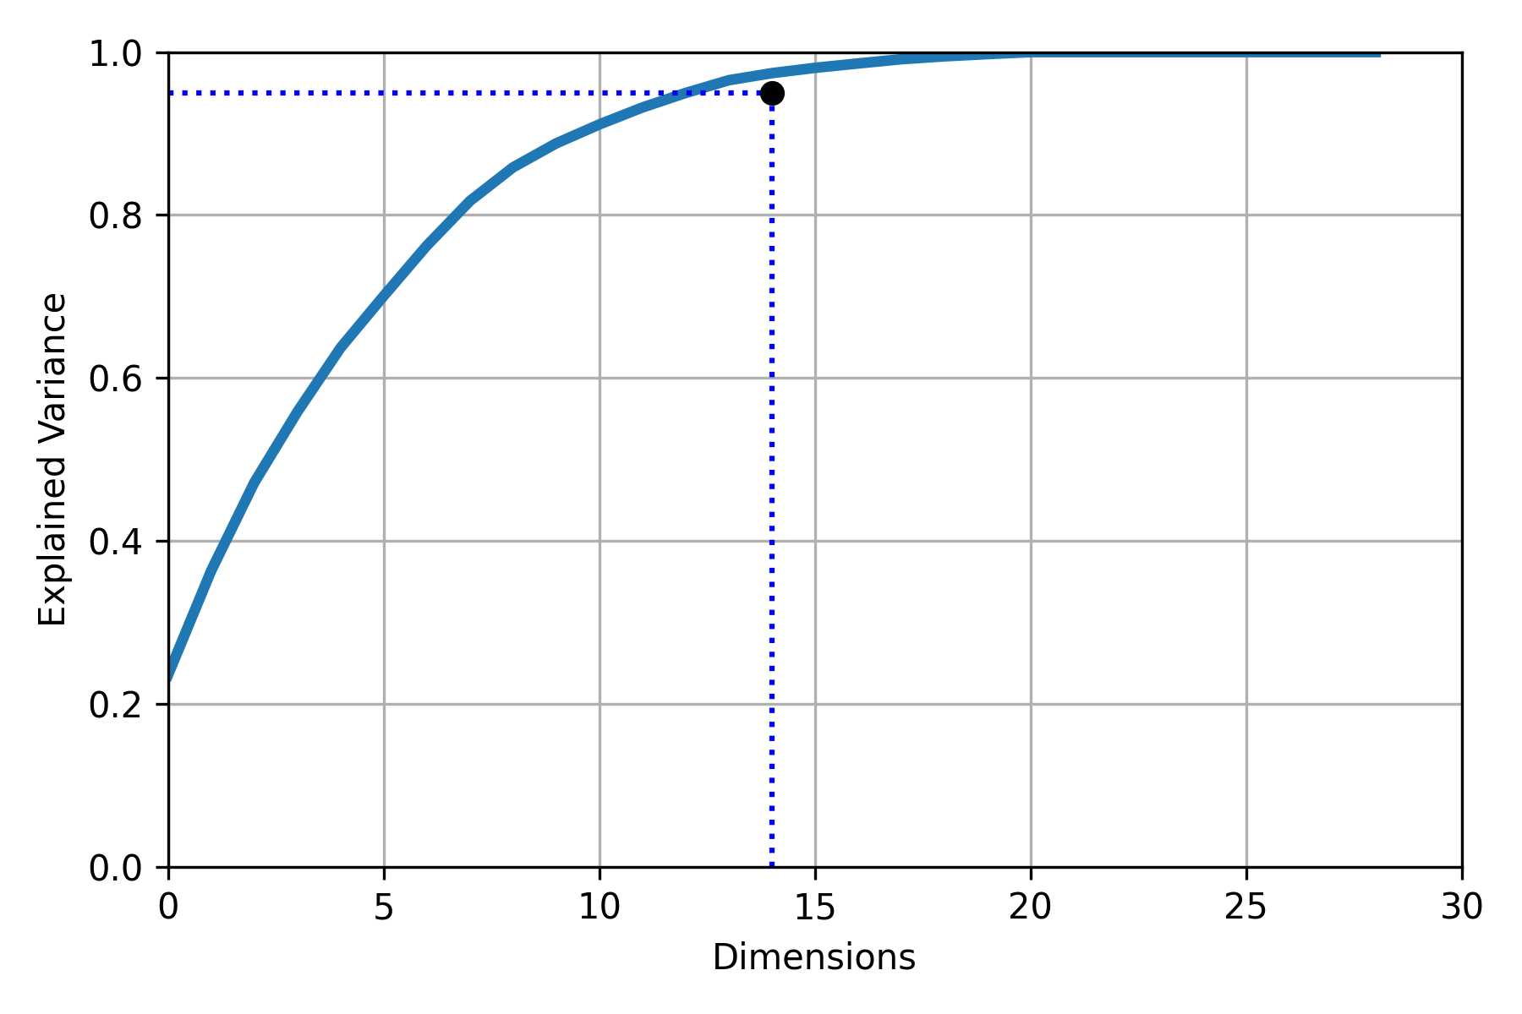
Dimensionality Reduction
Can maintain 95% variance with 14 features - half of the total, 30.

Slide 22
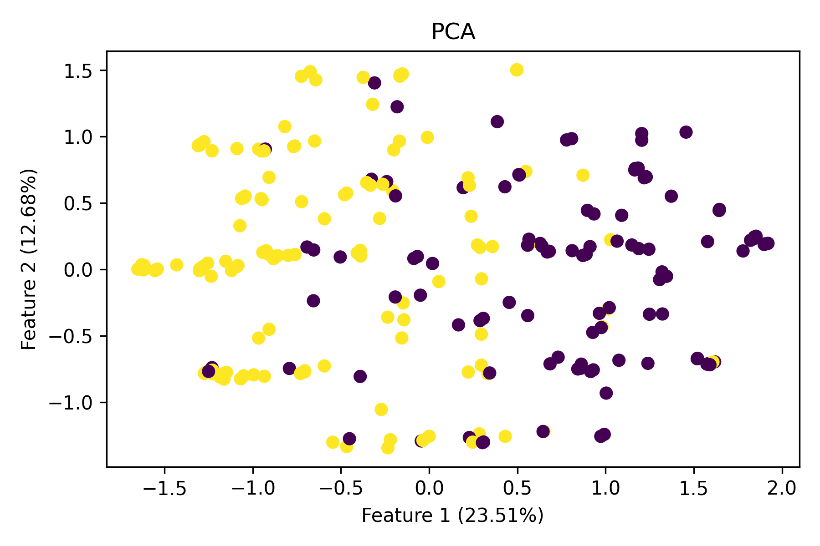
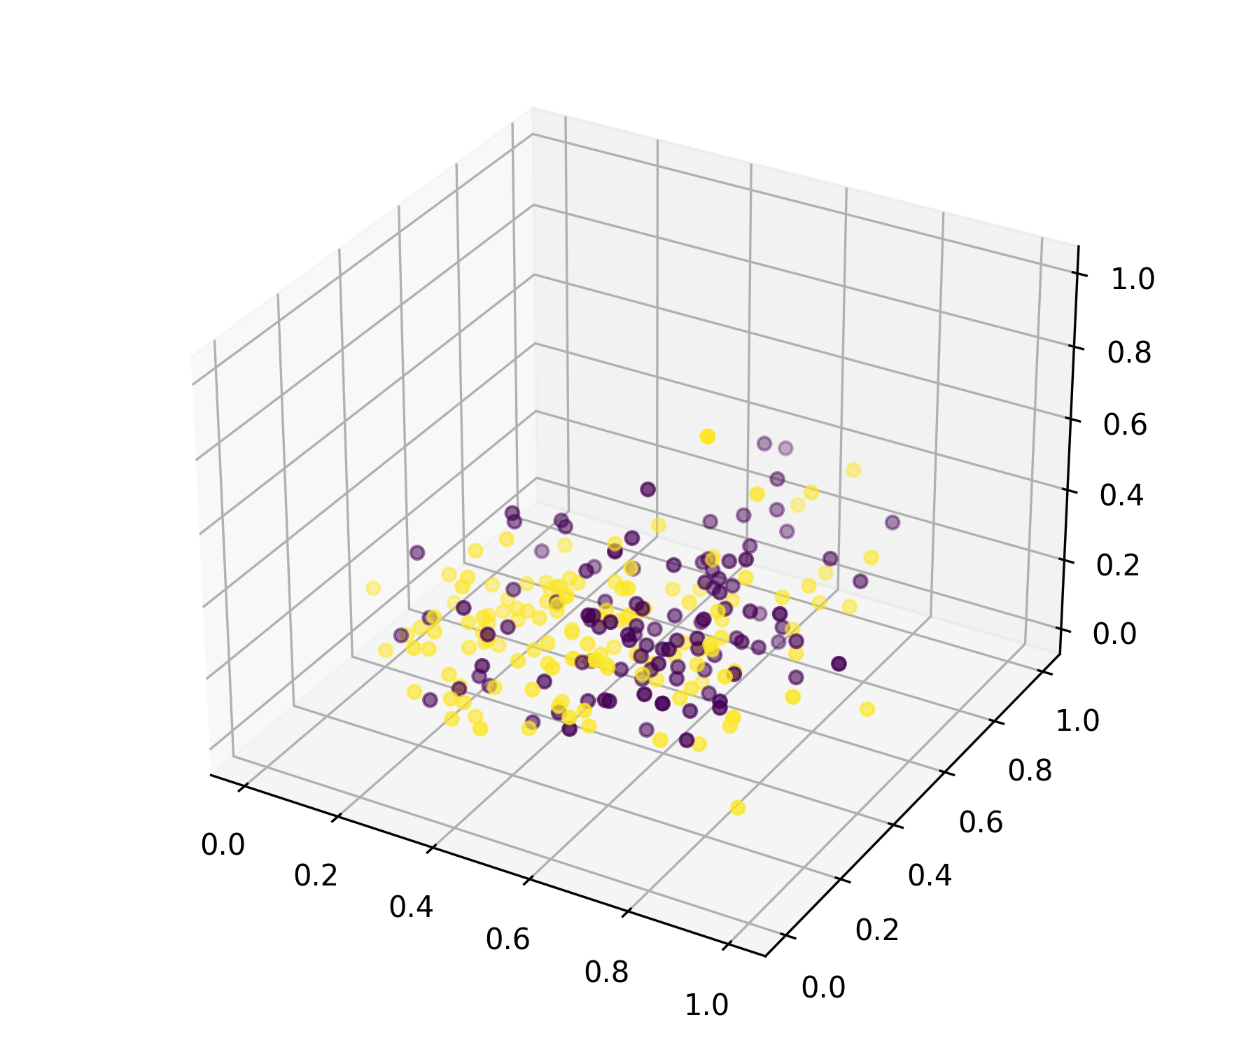
Dimensionality Reduction
2D/3D visualization show two clusters largely overlap

Slide 23
Dimensionality Reduction
 | SVC | PCA+ SVC | KernelPCA+ SVC
“At Risk” Recall | 0.97 | 0.84 | 0.87
Accuracy | 0.89 | 0.82 | 0.85

Slide 24
Ensemble Learning
 | XGBoost | VotingClassifier
“At Risk” Recall | 0.84 | 0.94
Accuracy | 0.84 | 0.87

Slide 25
AGENDA
Project Overview
Data Overview
EDA and Pipeline Set Up
ML Algorithms
Summary
Final Report
Known Limitations of Project
Potential Future Development

Slide 26
Summary & Final Report
The best estimator was SVC with an accuracy score of 0.89.
The recall score was 0.97.
Used MinMaxScaler(), OneHotEncoder(), and removed a feature to improve accuracy.
Dimensionality reduction did not improve accuracy.
Ensemble Learning did not improve accuracy.

Slide 27
AGENDA
Project Overview
Data Overview
EDA and Pipeline Set Up
ML Algorithms
Summary
Final Report
Known Limitations of Project
Potential Future Development

Slide 28
Known Limitations of Project
Does not consider ANNs
Small dataset (only 300 instances)
Did not fully investigate source and origin of MCI’s data

Slide 29
AGENDA
Project Overview
Data Overview
EDA and Pipeline Set Up
ML Algorithms
Summary
Final Report
Known Limitations of Project
Potential Future Development

Slide 30
Potential Future Development
Implement ANNs
Look into Deep Learning
Find larger datasets
Investigate origins of data
Add more features

Slide 31
References
https://www.kaggle.com/rashikrahmanpritom/heart-attack-analysis-prediction-dataset
https://archive.ics.uci.edu/ml/datasets/Heart+Disease
https://github.com/zachcarlson/HeartAttackPredictor/blob/main/HeartAttackPredictor.ipynb
https://en.wikipedia.org/wiki/ST_segment
https://towardsdatascience.com/heart-disease-uci-diagnosis-prediction-b1943ee835a7
(Background Image) https://www.wbur.org/news/2020/06/15/see-doctor-use-telemedicine-coronavirus

